Slide 1
The Instruction Set
The words of a machine’s language are called instructions.
It’s vocabulary is called the instruction set.
The instruction set we will study is the instruction set of the MIPS family of processors. Used mainly in the computers of Silicon Graphics but also in the products of Nintendo and Sony.

Slide 2
Addition & Subtraction
Every computer must be able to perform arithmetic. In MIPS the notation for addition is:
add a, b, c # a = b + c
Each MIPS arithmetic instruction performs only one operation and must have exactly three variables.
This conforms to the philosophy of keeping the hardware simple. This is the first of the 4 design principles: Simplicity favors regularity.
The notation for subtraction is:
sub a, b, c # a = b - c
sub a, a, b # a = a - b
sub b, a, a # b = 0

Slide 3
From C to Assembly
C
a = b + c;
d = a - e;
A more complex statement
f = (g + h) -
(i + j);
Assembly
add a, b, c
sub d, a, e
Entails the use of temporary variables
add t0, g, h
add t1, i, j
sub f, t0, t1

Slide 4
Operands of the Computer
Unlike programs in high-level languages the operands of arithmetic instructions can’t be any variable.
They must be from a limited number of special variables called registers.
The size of a register in the MIPS architecture is 32 bits. Groups of 32 bits are given the name word in MIPS.
One major difference between the variables of a programming language and registers is the limited number of registers, typically 32 on current computers.

Slide 5
Registers
Thus the 3 operands of the arithmetic instructions can be only registers.
The reason for the limit to 32 registers is found in the second design principle:
Smaller is faster.
In MIPS the names of the registers are 2 characters following a $ sign. We will use $s0,$s1,… for C variables and $t0,$t1,… for temporary variables.
f = (g + h) - (i + j); compiles into
add $t0,$s1,$s2 # $t0 = g + h
add $t1,$s3,$s4 # $t1 = i + j
sub $s0,$t0,$t1 # $s0 = $t0 - $t1

Slide 6
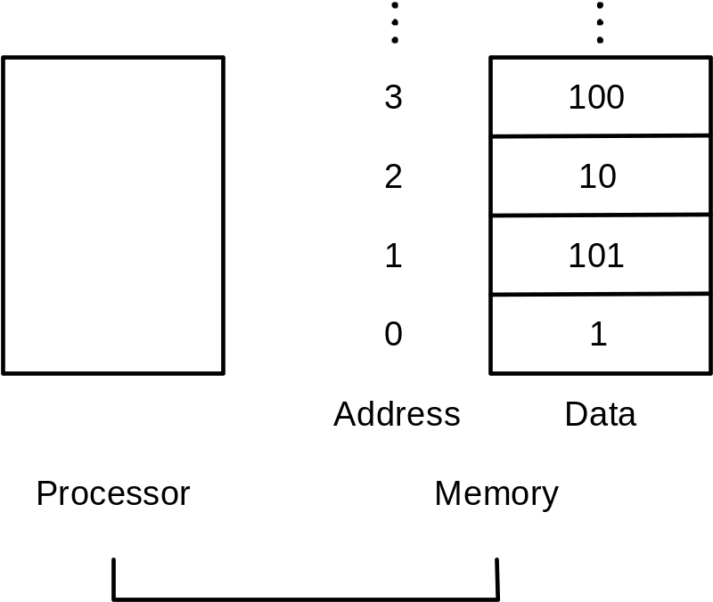
Memory
But if there are only 32 registers where do we store the rest of the variables?
In one of the 5 components - In Memory. The main memory of the computer contains millions of data elements.
Memory is just a large
1-dimensional array.
For example the address
of the 3rd data element is
2 and the value of
Memory[2] is 10.

Slide 7
The Load Instruction
But how do we operate on these memory elements? All arithmetic operations are between registers only?
We must add a new instruction that transfers data from memory to register. This instruction is called load. In MIPS it is called lw for load word.
g = h + A[8]; will compile into:
lw $t0, 8($s3) # $s3 holds the
# address of A
add $s1,$s2,$t0
The constant in a data transfer instruction is called the offset and the register the base register.

Slide 8
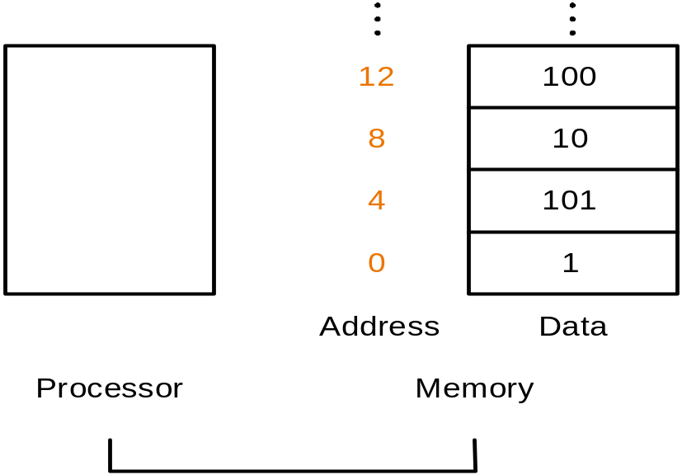
The Store Instruction
A[12] = h + A[8]; // all vars are ints
compiles into:
lw $t0,32($S3) # $t0 = A[8]
add $t0,$s2,$t0 # $t0 = h + A[8]
and know to the final instruction:
sw $t0,48($s3) # A[12] = $t0
sw stands for store word.
Words are 4 bytes long,
so when accessing an
int we count in multiples
of 4.

Slide 9
Using an Array Index
g = h + A[i]; // i is an index in $s4
compiles into
add $t1,$s4,$s4 # $t1 = i*2
add $t1,$t1,$t1 # $t1 = i*4;
add $t1,$t1,$t3 # $t1 = index + base
# address
lw $t0,0($t1) # $t0 = A[i]
add $s1,$s2,$t0 # g = h + A[i]
The register which holds the index is sometimes called the index register.

Slide 10
Representing Instructions
Lets look at the numbers behind the instructions:
add $t0,$s1,$s2
first as a combination of decimal numbers:
0 17 18 8 0 32
Each of the segments is called a field.
The first and last fields (0 and 32) tell the computer to perform addition.
The second field is the first operand (17 = $s1)
The third field is the second operand (18 = $s2)
The fourth field is the destination register (8 = $t0)
The fifth field is unused in this instruction.

Slide 11
Binary Representation
The instruction in its binary representation:
000000 10001 10010 01000 00000 100000
6 bits 5 bits 5 bits 5 bits 5 bits 6 bits
The numeric version of the instructions is called machine language or machine code. The layout of the instruction is the instruction format.
In MIPS all instructions are 32 bits long, like words,
this is to follow the design principle that simplicity favors regularity.

Slide 12
Instruction Formats
A problem occurs when an instruction needs longer fields. For example the load and store instructions must specify an offset. In the existing format the maximal field size is 5, thus the maximal offset is 2⁵ or 32. This is obviously to small.
We have a conflict between the desire to keep all instructions the same length and the desire to have a single instruction format. This leads to design principle 3:
Good design demands good compromise.
The MIPS designers made the compromise of having several instruction formats and a single instruction length.

Slide 13
R-format Instructions
MIPS R-format Instructions fields are given:
op rs rt rd shamt funct
6 bits 5 bits 5 bits 5 bits 5 bits 6 bits
Lets look at a add instruction: add $t0,$s1,$s2
op: basic operation of the instruction called opcode
rs: first register source operand
rt: second register source operand
rd: destination register, gets the result of the op
shamt: shift amount, used in shift instructions.
funct: selects the specific variant of the operation.

Slide 14
I-format Instructions
The first instruction format is called the R-format or R-type.
The second is called the I-format and is used for data transfers.
op rs rt address
6 bits 5 bits 5 bits 16 bits
Lets look at a load instruction:
lw $t0,32($s3) # $t0 = A[8]
rs: base address register ($s3)
rt: destination register ($t0)
address: offset of -2¹⁵ to 2¹⁵ bytes (32)

Slide 15
Branch Instructions
Decision making is possible using branches.
The following instructions are conditional branch instructions:
beq reg1,reg2,L1 #branch equal
goto the instruction labeled L1 if the register values are equal, if unequal goto the next instruction.
bne reg1,reg2,L1 #branch not equal
goto the instruction labeled L1 if the register values are’nt equal, if equal goto the next instruction.

Slide 16
Compiling an if Statement
if(i==j)
goto L1;
f=g+h;
L1: f=f-i;
beq $s3,$s4,L1
add $s0,$s1,$s2
L1: sub $s0,$s0,$s3
The label L1 is in fact an address, it is the address of the sub instruction. The assembler relieves the programmer or compiler of the task of having to compute the addresses of instructions. As you can guess the branch instructions are I-type instructions.

Slide 17
J-format Instructions
The first instruction format is called the R-format or R-type.
The second is called the I-format and is used for data transfers and branching conditionally.
The Third is called the J-format and is used for jumping unconditionally.
j loop.
op address
6 bits 26 bits
Lets look at a jump instruction:
Address:

Slide 18
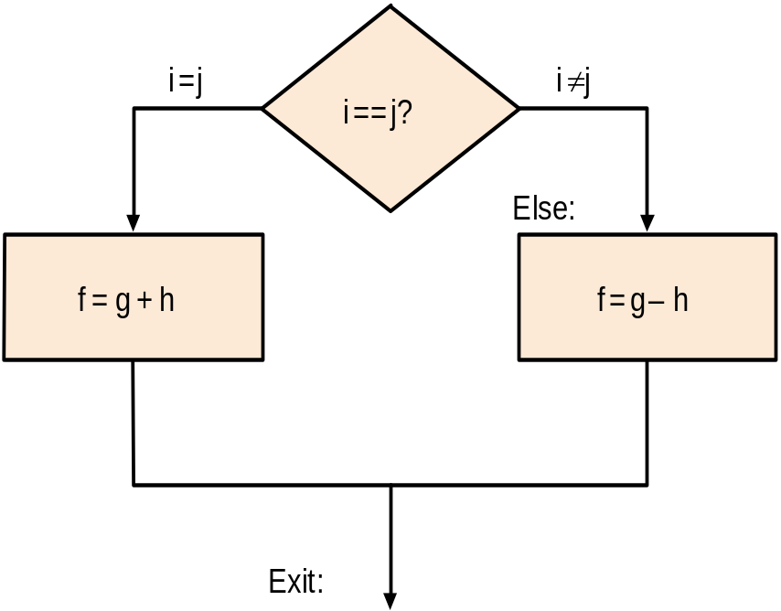
Compiling if-then-else
if(i==j)
f=g+h;
else
f=g-h;
bne $s3,$s4,Else
add $s0,$s1,$s2
j Exit
Else: sub $s0,$s1,$s2
Exit:
The j instruction (j for jump) is an unconditional branch instruction. The machine always follows the branch. j is of the J-format, 6 bits for opcode and 26 for jump address.

Slide 19
Loops
Loop: g=g+A[i];
i=i+j;
if(i!=h) goto Loop;
will compile into:
Loop: add $t1,$s3,$s3 # $t1=2*i
add $t1,$t1,$t1 # $t1=4*i
add $t1,$t1,$s5 # $t1=&A[i]
lw $t0,0($t1) # $t0=A[i]
add $s1,$s1,$t0 # g=g+A[i]
add $s3,$s3,$s4 # i=i+j
bne $s3,$s2,Loop# branch if i!=h

Slide 20
Compiling a while Loop
while(A[i]==k)
i=i+j;
will compile into:
Loop: add $t1,$s3,$s3 # $t1=2*i
add $t1,$t1,$t1 # $t1=4*i
add $t1,$t1,$s5 # $t1=&A[i]
lw $t0,0($t1) # $t0=A[i]
bne $t0,$s6,Exit# if A[i]!=k exit
add $s3,$s3,$s4 # i=i+j
j Loop
Exit:

Slide 21
Set on less than
In order to see if a variable is less than another variable (not just unequal), like in a for loop, the MIPS instruction set on less then or slt is used.
For example:
slt $t0,$s3,$s4
$t0 is set to 1 if $s3<$s4. Otherwise it is set to 0.
The C code if(a<b) would compile as:
slt $t0,$s0,$s1 #$t0=1 if a<b
bne $t0,$zero,Less#goto Less if $t0!=0
$zero is register 0 which always contains 0.

Slide 22
Why Not a blt
Why didn't the MIPS designers add a blt (branch on less than) instruction?
The reason is simplicity. A blt instruction would be to complicated. Either it would stretch the clock cycle or it would take extra clock cycles to perform.
Two faster instruction are more useful.

Slide 23
Procedures
When executing a procedure (function in C) the program must follow the next 6 steps:
1. Place parameters in a place the procedure can access them.
2. Jump to the procedure code.
3. Allocate storage needed for the procedure.
4. Perform the task.
5. Place the result(s) in a place the calling program can access.
6. Return to the point of origin.

Slide 24
Registers for Procedures
MIPS software allocates the following of its 32 registers for procedure calling:
  $a0 - $a3: 4 argument registers in which to pass parameters.
  $v0 - $v1: 2 value registers in which to return values
  $ra: 1 return address register to return to point of origin.
2 new instructions that support procedures are:
jal ProcedureAddress
Jump and link, jump to the procedure and save the address of the following instruction in $ra.
jr register
Jump register, jump to the address in the register.

Slide 25
Using More Registers
If the compiler needs more than the 4 input and 2 output registers, it can use other registers.
But it must restore the values in those registers to the values before the procedure was called.
This is a case of register spill, register values are saved in memory.
The ideal structure for saving registers is the stack,
values are pushed onto the stack before the procedure call and poped out after.
MIPS software allocates a register called the stack pointer ($sp) to point to the address in memory where the stack resides.

Slide 26
Compiling a Leaf Procedure
int leaf(int g,int h,int i,int j){
int f;// the arguments are in $a0-$a3,
f=(g+h) - (i+j); //f is in $s0
return f;
}
Before continuing we will introduce a new instruction:
addi $t0,$t0,10# $t0=$t0+10
add immediate (addi) has as one of its operands an immediate value. addi is of the I-type instructions and in fact gives the format its name.

Slide 27
The Assembly Version
subi $sp,$sp,12#make room for 3 items on stack
sw $t1,8($sp) #save $t1
sw $t0,4($sp) #save $t0
sw $s0,0($sp) #save $s0
add $t0,$a0,$a1 # $t0=g+h
add $t1,$a2,$a3 # $t1=i+j
sub $s0,$t0,$t1 # f=$t0+$t1
add $v0,$s0,$zero # $v0=$s0
lw $s0,0($sp) #restore $s0
lw $t0,4($sp) #restore $t0
lw $t1,8($sp) #restore $t1
addi $sp,$sp,12#remove the room on the stack
jr $ra #jump back to point of origin

Slide 28
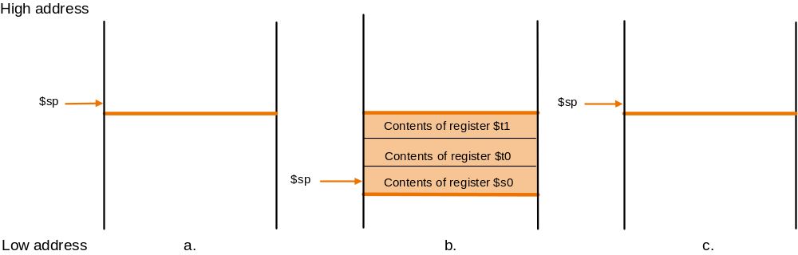
Picture of Stack
In order to avoid saving registers that might not be used in the future, MIPS software offers 2 classes of registers:
$t0-$t9: 10 temporary registers, not saved by the
procedure.
$s0-$s7: 8 saved registers, saved by the
procedure.

